Slide 1
MTA Daily Ridership Analysis
Using Power BI and SQL

Slide 2
Project Overview
- This project analyzes the MTA's ridership trends during and after the COVID-19 pandemic.
- Tools used: SQL for data querying and Power BI for visualization.
- Source: MTA Daily Ridership dataset from March 2020 onwards.

Slide 3
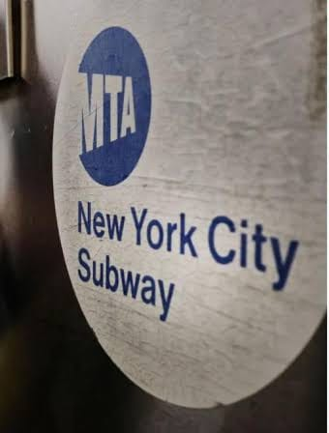
About the MTA
The Metropolitan Transportation Authority (MTA) operates the largest transportation network in North America.
Includes subways, buses, railroads (LIRR, Metro-North), bridges, tunnels, and paratransit services.
Serves NYC and parts of NY State and Connecticut.

Slide 4
Data Cleaning with SQL
SQL was used to identify and handle missing data:
Examples:
SELECT * FROM MTA_Daily_Ridership WHERE 'Date' IS NULL
SELECT * FROM MTA_Daily_Ridership WHERE 'Subways_Total_Ridership' IS NULL

Slide 5
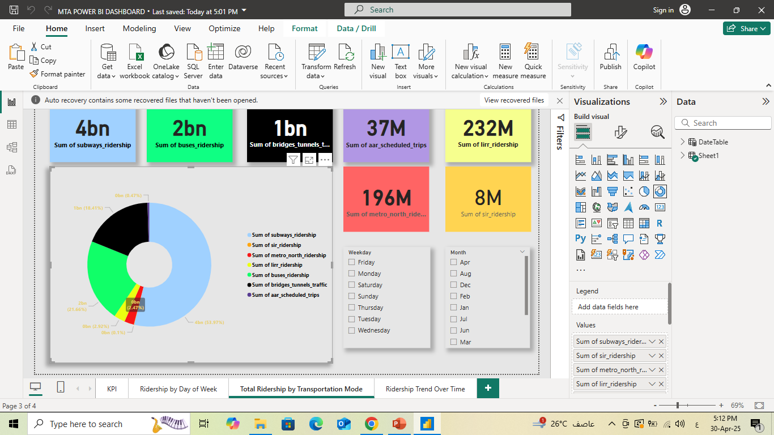
Total Ridership by Year
Query:
SELECT Year, SUM(Subways_Total_Ridership), ... GROUP BY Year

Slide 6
Average Ridership by Mode
Query used AVG() function to calculate:
Average Subways, Buses, AAR, LIRR, MNR, SIR, and Bridges & Tunnels ridership.

Slide 7
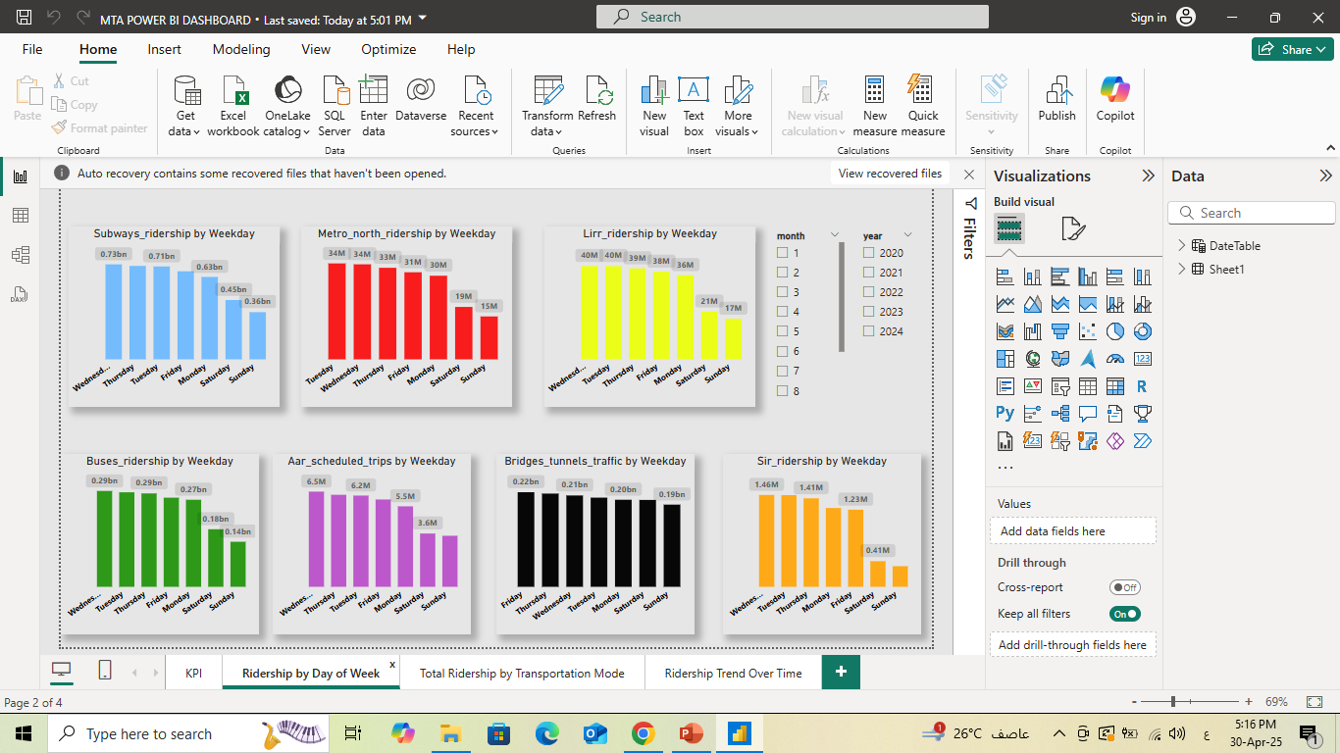
Weekday vs Weekend Ridership
Query grouped ridership by day type:
- Weekday: Monday to Friday
- Weekend: Saturday and Sunday

Slide 8
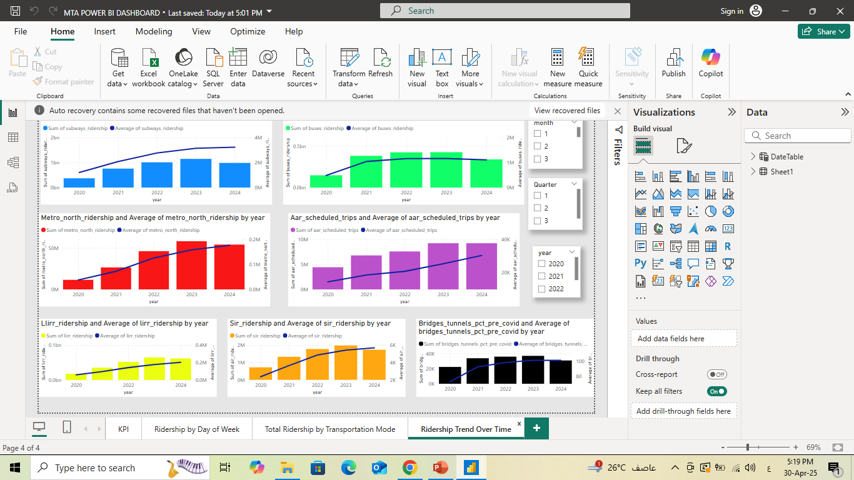
Pandemic Recovery Analysis
Recovery rates compared to pre-pandemic (2019) values.
Queries aggregated monthly and yearly recovery percentages.

Slide 9
Peak and Low Ridership Days
SQL was used to find the highest and lowest ridership days by mode:
Example:
SELECT TOP 1 [Date], [Subways_Total_Ridership] ORDER BY DESC

Slide 10
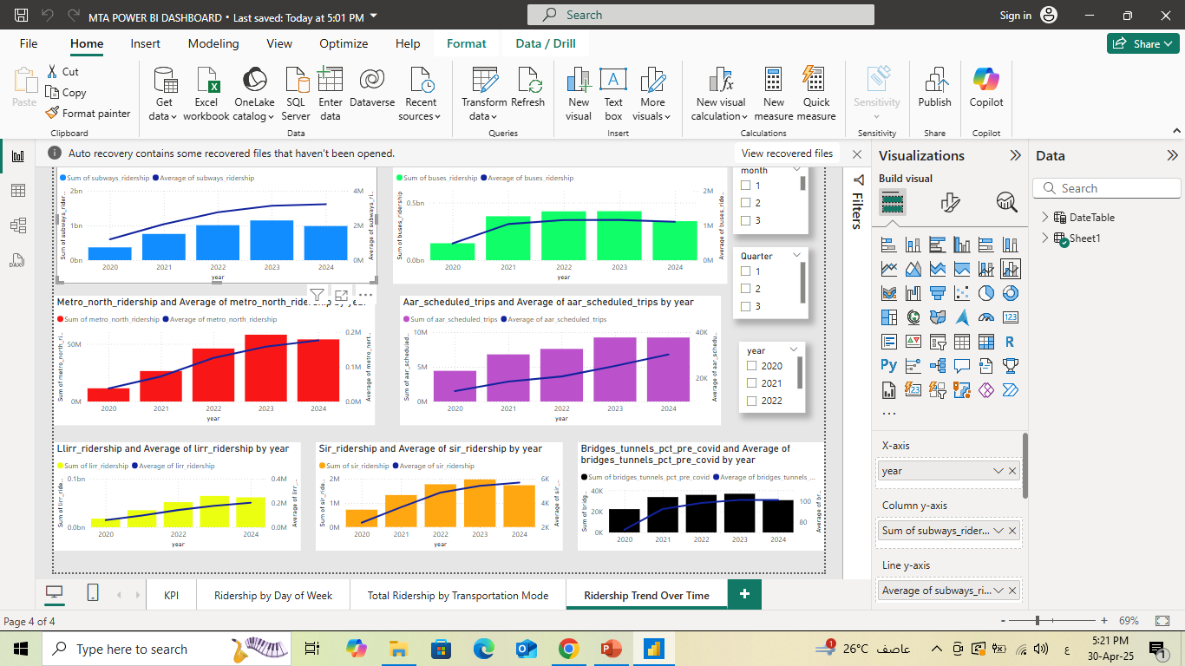
Modes Most Affected by the Pandemic
- Compared average recovery percentage by transport mode.
- Identified the fastest and slowest recovering services.

Slide 11
Railroad Usage Yearly
Compared usage across:
- LIRR
- MNR
- SIR
Using:
SELECT Year, SUM(...) GROUP BY Year

Slide 12
Conclusion
- Subways had highest total ridership.
- Weekend ridership lagged behind weekday.
- AAR and SIR were most impacted by the pandemic.
- Recovery is ongoing but shows clear progress.

Slide 13
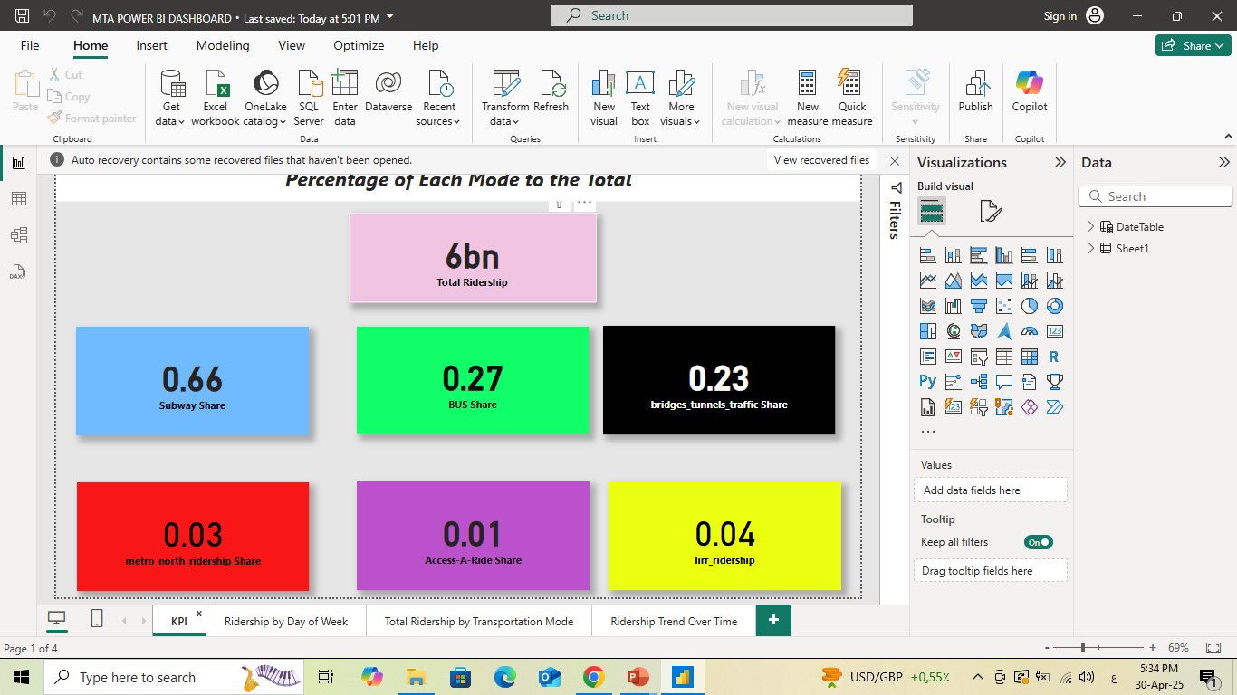

Slide 14


Slide 15
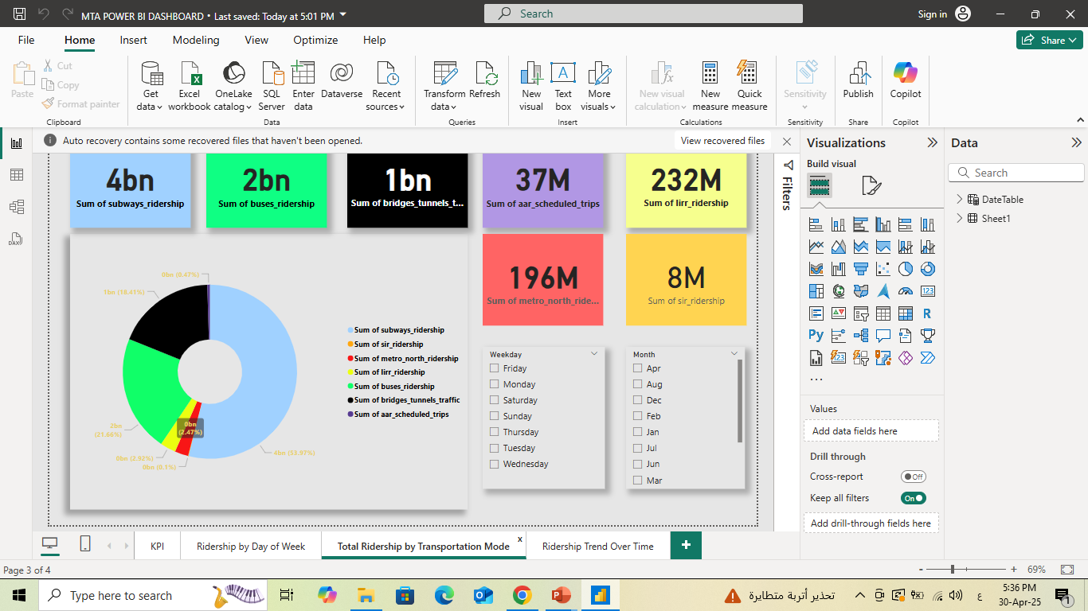

Slide 16


Slide 17
Thank You
Questions & Discussion
Prepared by: samr said , lamiaa abd el megid , Nermin mohssen gad el rab , Mahmoud nasef

